Slide 1



November 3, 2025
5:30 P.M.
Team 5095 Presents
TASTE OF HARLEM
A Local Restaurant Ordering & Delivery System
Angus
Chen
Brianna
Hayles
Jing Han
Lin
Diana
Lucero
Alisha
Mughal
Krista U
Singh

Slide 2




WHAT, WHO, HOW, & WHY?
What’s the Idea?
Who Needs It?
Why Invest?
A full-stack web app that connects customers, local restaurants, and delivery drivers in one simple platform.
Customers: For ordering food simply and quickly.
The platform focuses on the West Harlem restaurant ecosystem, which is an up-and-coming neighborhood. This creates an environment for growth due to the influx of new residents and their demand for local food.
Restaurant Staff: A platform to manage menus, orders, and revenue without high third-party fees.
It allows for customers to order food, restaurants to manage menus and orders, and drivers to choose what orders to deliver.
Delivery Drivers: Can accept & complete deliveries.
2

Slide 3


REVENUE STREAMS
Commission per Order: Small percentage from each transaction.
Delivery Fee Sharing: Shared per-order delivery fees between driver and platform
Premium Subscriptions: Restaurants can pay monthly to access analytics, performance insights, and advertising slots.
Data Insights Sales: Aggregated order trend data sold to partners such as food distributors.
3

Slide 4
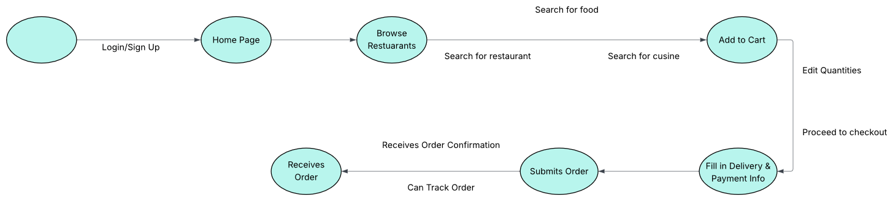
USE CASES
Customer Ordering Flow
Restaurant Ordering Flow
4

Slide 5

BACKEND OVERVIEW
The backend is the core of the system: managing user authentication, order processing, and revenue tracking while maintaining direct database control. Built for speed, clarity, and scalability, and fully integrated with the frontend.
Framework & Database Connection
Architecture & Code Structure
Key Features
Python (FastAPI Framework):
High Performing
Built-In Validation
Automatic API Documentation
AWS RDS MySQL Database:
Cloud-hosted for scalability
Raw SQL Queries (No ORM):
CRUD operations use manual SQL statements
/app.py ⟶ main FastAPI app with 11 total endpoints
/database/connection.py ⟶ connects to AWS RDS instance
/database/queries.py ⟶ raw SQL queries for all entities
/routes/ ⟶ separate files for modular endpoints
auth.py ⟶ user registration & validation
restaurants.py ⟶ restaurant browsing & menu retrieval
orders.py ⟶ order creation, validation, and delivery assignment
reports.py ⟶ revenue analytics
Robust data validation
Error handling with user-friendly JSON messages
Frontend-backend integration
API Testing
5

Slide 6
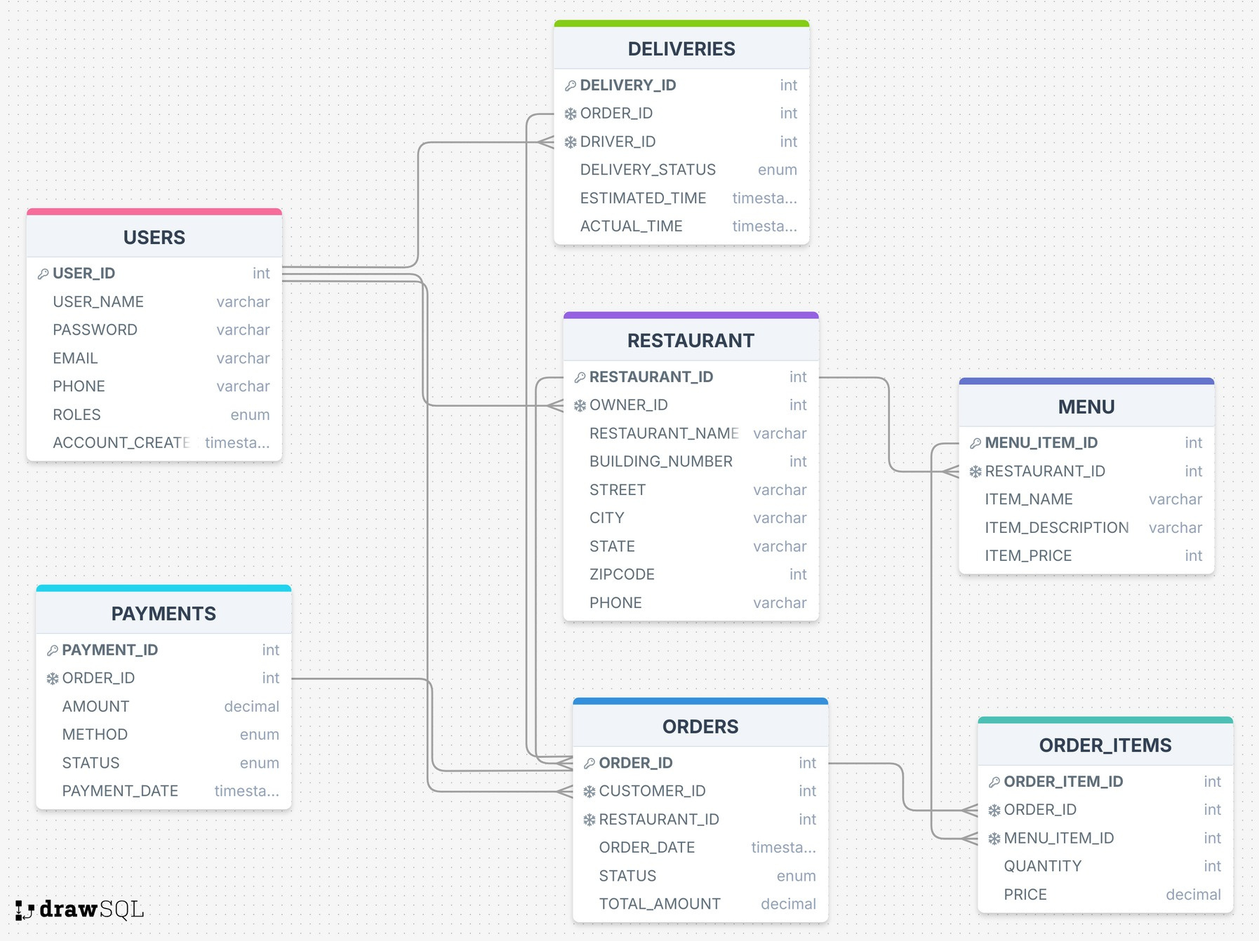









THE DATA
Primary Key Foreign Key
1:1 1:M
Hosted by:
6

Slide 7

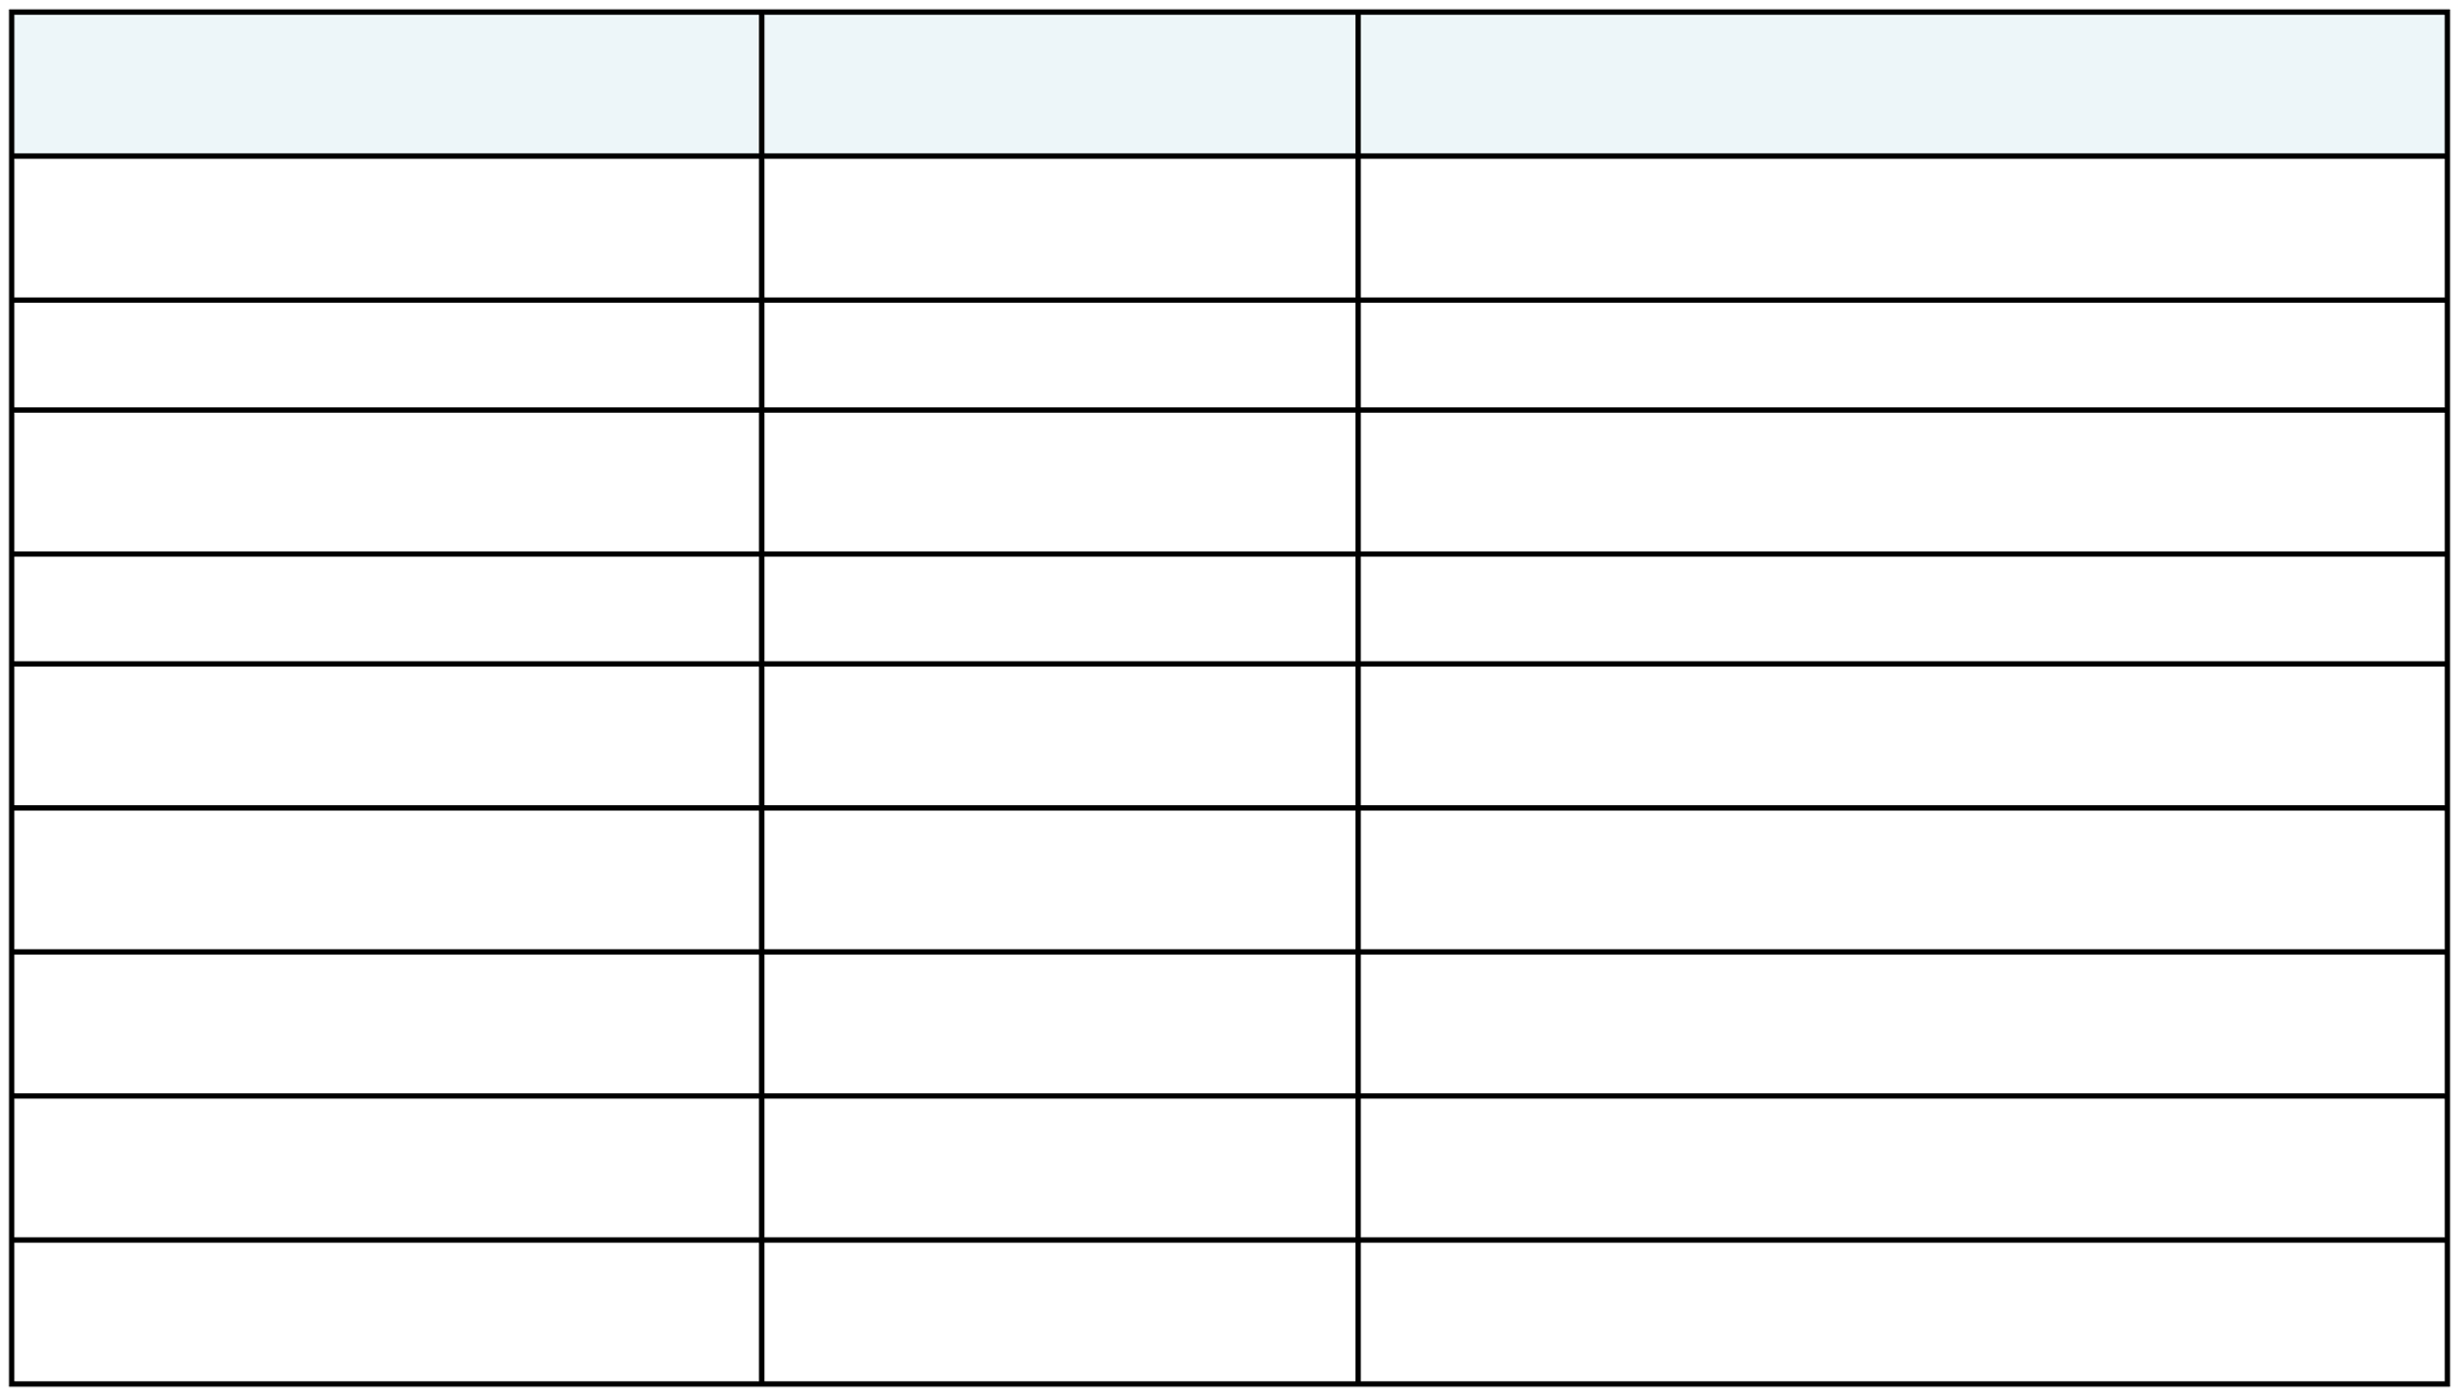
THE DATA (CONT)
RELATIONSHIP
CARDINALITY
DESCRIPTION
USER ⟶ RESTAURANT
1
⟶
M
A user (role = restaurant_owner) can own many restaurants
USER ⟶ ORDERS
1
⟶
M
A user (role = customer) can place many orders
USER ⟶ DELIVERIES
1
⟶
M
A user (role = driver) can handle multiple deliveries
RESTAURANT ⟶ MENU
1
⟶
M
A restaurant can have multiple menu items
RESTAURANT ⟶ ORDERS
1
⟶
M
A restaurant can have many orders
ORDERS ⟶ ORDER_ITEMS
1
⟶
M
An order can contain multiple order items
MENU ⟶ ORDER_ITEMS
1
⟶
M
A menu item can appear in many order items
ORDERS ⟶
PAYMENTS
1
⟶
1
Each order has one payment record
ORDERS ⟶ DELIVERIES
1
⟶
1
Each order has one delivery record
7

Slide 8

THE STACK
Front End
Back End
DevOps & Deployment
(client side)
(server side)
Framework: Next.js (React)
Language: TypeScript, JavaScript
Styling: Tailwind CSS
Purpose: Handle user interface and experience
Framework: FastAPI (Python)
Database: MySQL (hosted by AWS RDS)
Purpose: Manages business affairs and user authentication
Containerization: Docker
Version Control: GitHub
Cloud Hosting: AWS RDS for database and deploying the app
8

Slide 9
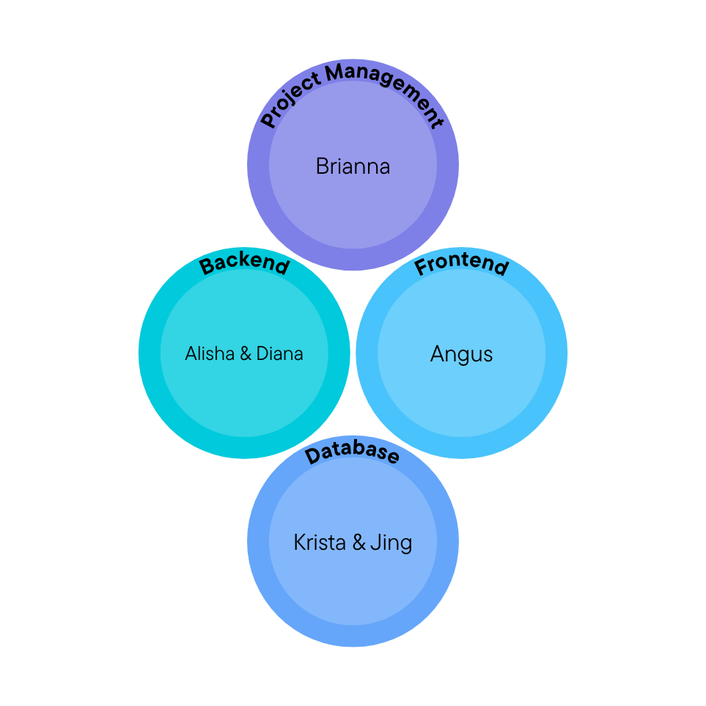
MEMBER ROLES
9

Slide 10
NEXT STEPS
Customer Loyalty Program
Featured Restaurant Listings
Tableau Dashboard for Excel Reporting
A reward system that gives points, discounts, and free deliveries to users based on their spending.
Restaurants can pay for premium placement within the app. When users browse the app for places to eat, paying restaurants will appear at the top of relevant sections.
Provides restaurants & administrators with real-time insights into orders, revenue, customer satisfaction, and delivery performance.
10

Slide 11
THANK YOU
ANY QUESTIONS?
11

